Slide 1
Corner Detection
Basic idea: Find points where two edges meet—i.e., high gradient in two directions
“Cornerness” is undefined at a single pixel, because there’s only one gradient per point
  Look at the gradient behavior over a small window
Categories image windows based on gradient statistics
  Constant: Little or no brightness change
  Edge: Strong brightness change in single direction
  Flow: Parallel stripes
  Corner/spot: Strong brightness changes in orthogonal directions
Computer Vision : CISC 4/689

Slide 2
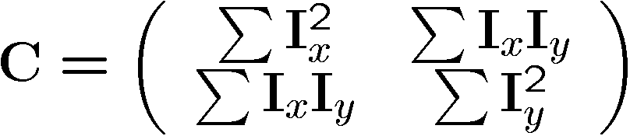
Corner Detection:
Analyzing Gradient Covariance
Intuitively, in corner windows both I_{x} and I_{y} should be high
  Can’t just set a threshold on them directly, because we want rotational invariance
Analyze distribution of gradient components over a window to differentiate between types from previous slide:
The two eigenvectors and eigenvalues ¸₁, ¸₂ of C (Matlab: eig(C)) encode the predominant directions and magnitudes of the gradient, respectively, within the window
Corners are thus where min(¸₁, ¸₂) is over a threshold
courtesy of Wolfram
Computer Vision : CISC 4/689

Slide 3
Contents
Harris Corner Detector
  Description
  Analysis
Detectors
  Rotation invariant
  Scale invariant
  Affine invariant
Descriptors
  Rotation invariant
  Scale invariant
  Affine invariant
Computer Vision : CISC 4/689

Slide 4
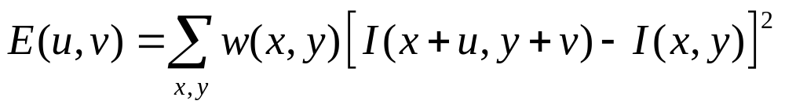
Harris Detector: Mathematics
Change of intensity for the shift [u,v]:
Window function
Shifted intensity
Intensity
Window function w(x,y) =
or
1 in window, 0 outside
Gaussian
Computer Vision : CISC 4/689

Slide 5
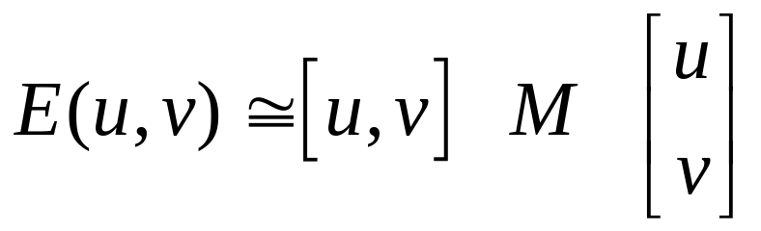
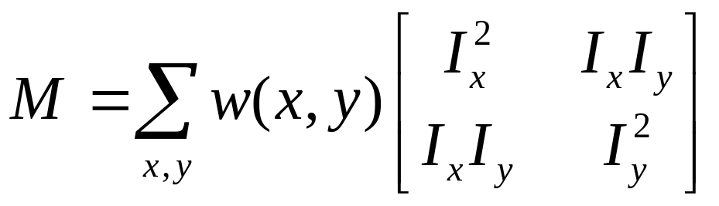
Harris Detector: Mathematics
For small shifts [u,v] we have a bilinear approximation:
where M is a 2×2 matrix computed from image derivatives:
Computer Vision : CISC 4/689

Slide 6
Harris Detector: Mathematics
Intensity change in shifting window: eigenvalue analysis
λ₁, λ₂ – eigenvalues of M
If we try every possible orientation n,
the max. change in intensity is λ₂
Ellipse E(u,v) = const
(λ_{max})^{-1/2}
(λ_{min})^{-1/2}
Computer Vision : CISC 4/689

Slide 7
Harris Detector: Mathematics
Classification of image points using eigenvalues of M:
λ₂
“Edge”
λ₂ >> λ₁
“Corner”
λ₁ and λ₂ are large,
λ₁ ~ λ₂;
E increases in all directions
λ₁ and λ₂ are small;
E is almost constant in all directions
“Flat” region
“Edge”
λ₁ >> λ₂
λ₁
Computer Vision : CISC 4/689

Slide 8
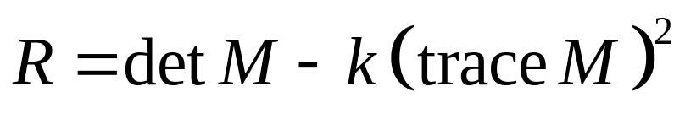
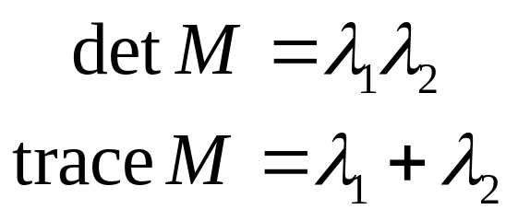
Harris Detector: Mathematics
Measure of corner response:
(k – empirical constant, k = 0.04-0.06)
Computer Vision : CISC 4/689

Slide 9
Harris Detector: Mathematics
λ₂
“Edge”
“Corner”
R depends only on eigenvalues of M
R is large for a corner
R is negative with large magnitude for an edge
|R| is small for a flat region
R < 0
R > 0
“Flat”
“Edge”
|R| small
R < 0
λ₁
Computer Vision : CISC 4/689

Slide 10
Harris Detector
The Algorithm:
  Find points with large corner response function R (R > threshold)
  Take the points of local maxima of R
Computer Vision : CISC 4/689

Slide 11
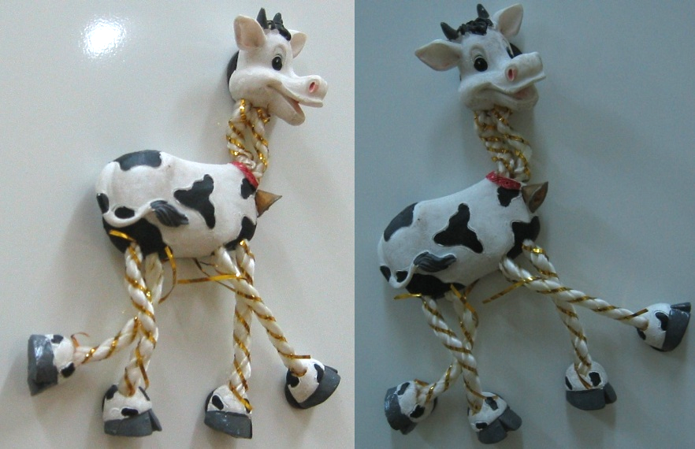
Harris Detector: Workflow
Computer Vision : CISC 4/689

Slide 12
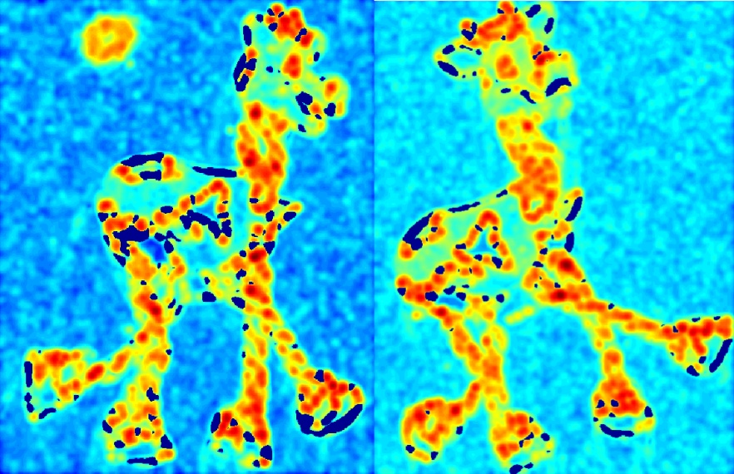
Harris Detector: Workflow
Compute corner response R
Computer Vision : CISC 4/689

Slide 13
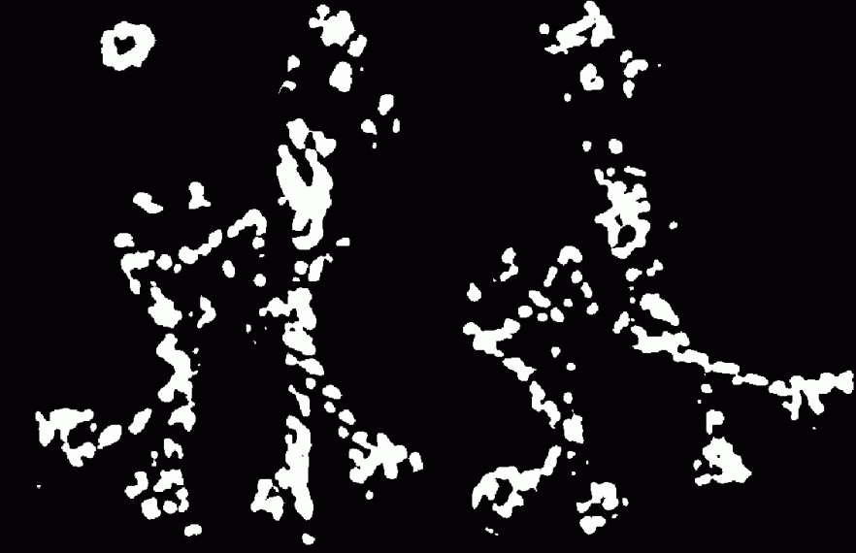
Harris Detector: Workflow
Find points with large corner response: R>threshold
Computer Vision : CISC 4/689

Slide 14
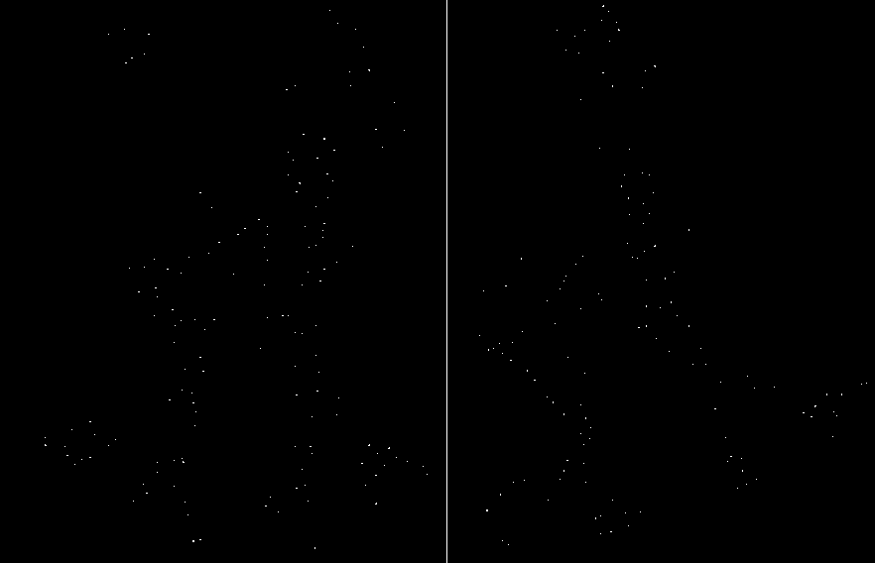
Harris Detector: Workflow
Take only the points of local maxima of R
Computer Vision : CISC 4/689

Slide 15
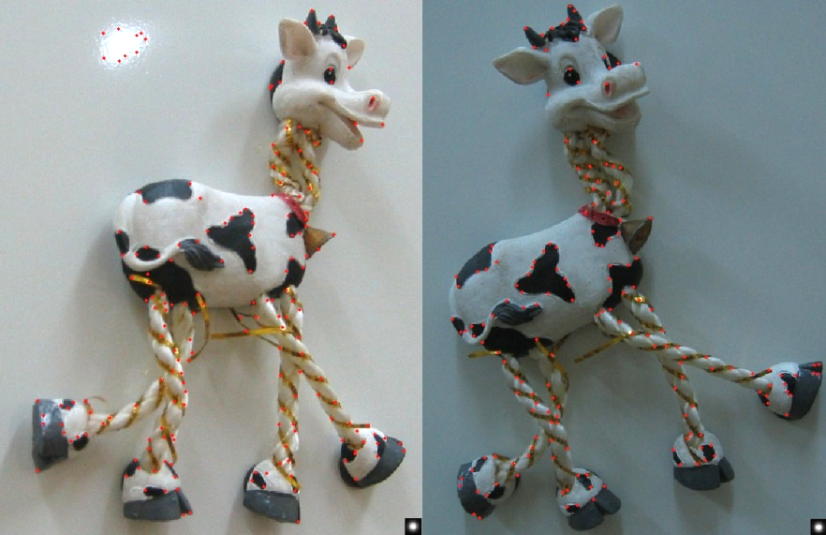
Harris Detector: Workflow
Computer Vision : CISC 4/689

Slide 16
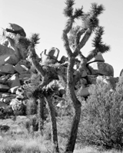
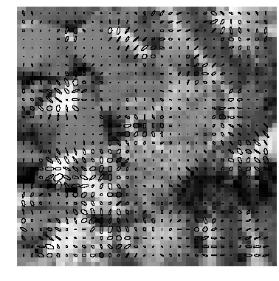
Example: Gradient Covariances
Corners are where both eigenvalues are big
from Forsyth & Ponce
Detail of image with gradient covar-
iance ellipses for 3 x 3 windows
Full image
Computer Vision : CISC 4/689

Slide 17
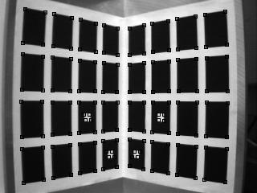
Example: Corner Detection
(for camera calibration)
Computer Vision : CISC 4/689
courtesy of B. Wilburn

Slide 18
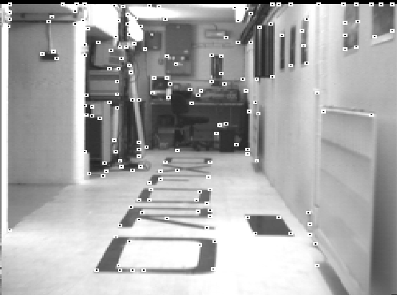
Example: Corner Detection
courtesy of S. Smith
SUSAN corners
Computer Vision : CISC 4/689

Slide 19
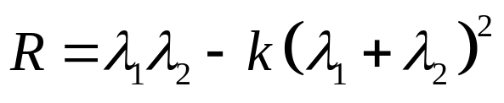
Harris Detector: Summary
Average intensity change in direction [u,v] can be expressed as a bilinear form:
Describe a point in terms of eigenvalues of M:
measure of corner response
A good (corner) point should have a large intensity change in all directions, i.e. R should be large positive
Computer Vision : CISC 4/689

Slide 20
Contents
Harris Corner Detector
  Description
  Analysis
Detectors
  Rotation invariant
  Scale invariant
  Affine invariant
Descriptors
  Rotation invariant
  Scale invariant
  Affine invariant
Computer Vision : CISC 4/689

Slide 21
Tracking: compression of video information
Harris response (uses criss-cross gradients)
Dinosaur tracking (using features)
Dinosaur Motion tracking (using correlation)
Final Tracking (superimposed)
Courtesy: (http://www.toulouse.ca/index.php4?/CamTracker/index.php4?/CamTracker/FeatureTracking.html)
This figure displays results of feature detection over the dinosaur test sequence with the algorithm set to extract the 6 most "interesting" features at every image frame.
It is interesting to note that although no attempt to extract frame-to-frame feature correspondences was made, the algorithm still extracts the same set of features at every frame.
This will be useful very much in feature tracking.
Computer Vision : CISC 4/689

Slide 22
One More..
Office sequence
Office Tracking
Computer Vision : CISC 4/689

Slide 23
Harris Detector: Some Properties
Rotation invariance
Ellipse rotates but its shape (i.e. eigenvalues) remains the same
Corner response R is invariant to image rotation
Computer Vision : CISC 4/689

Slide 24
Harris Detector: Some Properties
Partial invariance to affine intensity change
Only derivatives are used => invariance to intensity shift I → I + b
Intensity scale: I → a I
R
R
threshold
x (image coordinate)
x (image coordinate)
Computer Vision : CISC 4/689

Slide 25
Harris Detector: Some Properties
But: non-invariant to image scale!
All points will be classified as edges
Corner !
Computer Vision : CISC 4/689

Slide 26
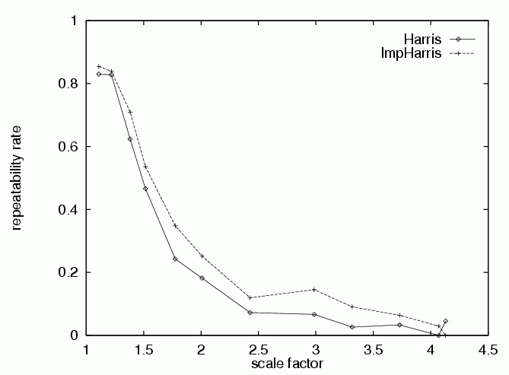
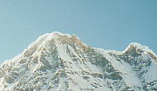

Harris Detector: Some Properties
Quality of Harris detector for different scale changes
-- Correspondences calculated using distance (and threshold)
-- Improved Harris is proposed by Schmid et al
-- repeatability rate is defined as the number of points
repeated between two images w.r.t the total number of
detected points.
ε Repeatability rate:
# correspondences
# possible correspondences
Imp.Harris uses derivative of Gaussian
instead of standard template used by
Harris et al.
Computer Vision : CISC 4/689
C.Schmid et.al. “Evaluation of Interest Point Detectors”. IJCV 2000

Slide 27
Contents
Harris Corner Detector
  Description
  Analysis
Detectors
  Rotation invariant
  Scale invariant
  Affine invariant
Descriptors
  Rotation invariant
  Scale invariant
  Affine invariant
Computer Vision : CISC 4/689

Slide 28
We want to:
detect the same interest points regardless of image changes
Computer Vision : CISC 4/689

Slide 29
Models of Image Change
Geometry
  Rotation
  Similarity (rotation + uniform scale)
  Affine (scale dependent on direction)
  valid for: orthographic camera, locally planar object
Photometry
  Affine intensity change (I → a I + b)
Computer Vision : CISC 4/689

Slide 30
Contents
Harris Corner Detector
  Description
  Analysis
Detectors
  Rotation invariant
  Scale invariant
  Affine invariant
Descriptors
  Rotation invariant
  Scale invariant
  Affine invariant
Computer Vision : CISC 4/689

Slide 31
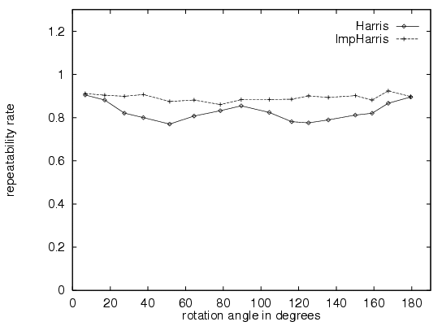
Rotation Invariant Detection
Harris Corner Detector
Computer Vision : CISC 4/689
C.Schmid et.al. “Evaluation of Interest Point Detectors”. IJCV 2000

Slide 32
Contents
Harris Corner Detector
  Description
  Analysis
Detectors
  Rotation invariant
  Scale invariant
  Affine invariant
Descriptors
  Rotation invariant
  Scale invariant
  Affine invariant
Computer Vision : CISC 4/689

Slide 33
Scale Invariant Detection
Consider regions (e.g. circles) of different sizes around a point
Regions of corresponding sizes (at different scales) will look the same in both images
Fine/Low
Coarse/High
Computer Vision : CISC 4/689

Slide 34
Scale Invariant Detection
The problem: how do we choose corresponding circles independently in each image?
Computer Vision : CISC 4/689

Slide 35
Scale Invariant Detection
Solution:
  Design a function on the region (circle), which is “scale invariant” (the same for corresponding regions, even if they are at different scales)
Example: average intensity. For corresponding regions (even of different sizes) it will be the same.
  For a point in one image, we can consider it as a function of region size (circle radius)
f
Image 1
f
Image 2
scale = 1/2
Computer Vision : CISC 4/689
region size
region size

Slide 36
Scale Invariant Detection
Common approach:
Take a local maximum of this function
Observation: region size (scale), for which the maximum is achieved, should be invariant to image scale.
Important: this scale invariant region size is found in each image independently!
Max. is called characteristic scale
f
Image 1
f
Image 2
scale = 1/2
Computer Vision : CISC 4/689
s₁
region size/scale
s₂
region size/scale

Slide 37
Characteristic Scale
Max. is called characteristic scale
The ratio of the scales, at which the extrema were found for corresponding points in two rescaled images, is equal to the scale factor between the images.
Characteristic Scale: Given a point in an image, compute the function responses for several factors s_{n} The characteristic scale is the local max. of the function (can be more than one).
Easy to look for zero-crossings of 2nd derivative than maxima.
f
Image 1
f
Image 2
scale = 1/2
s₁
region size/scale
s₂
region size/scale
Computer Vision : CISC 4/689

Slide 38
Scale Invariant Detection
A “good” function for scale detection:
has one stable sharp peak
f
f
f
Good !
bad
bad
region size
region size
region size
For usual images: a good function would be the one with contrast (sharp local intensity change)
Computer Vision : CISC 4/689

Slide 39
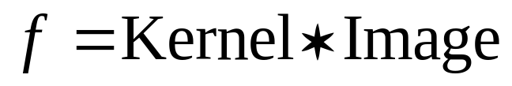
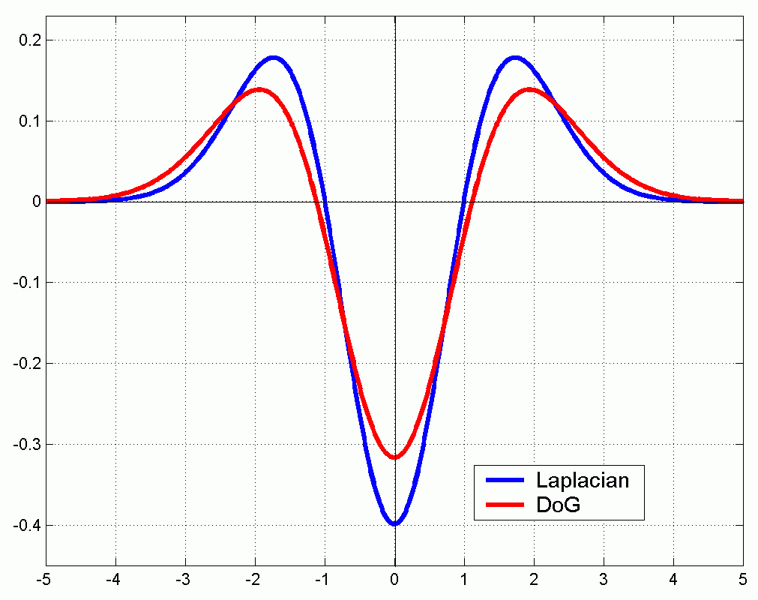
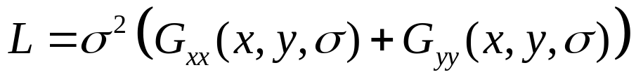

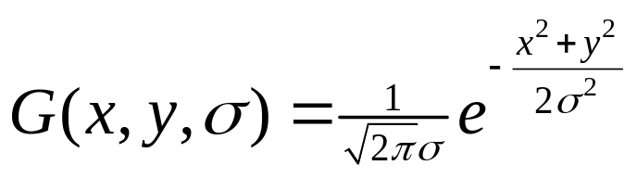
Scale Invariant Detection
Functions for determining scale
Kernels:
(Laplacian)
(Difference of Gaussians)
where Gaussian
Note: both kernels are invariant to scale and rotation
Computer Vision : CISC 4/689

Slide 40
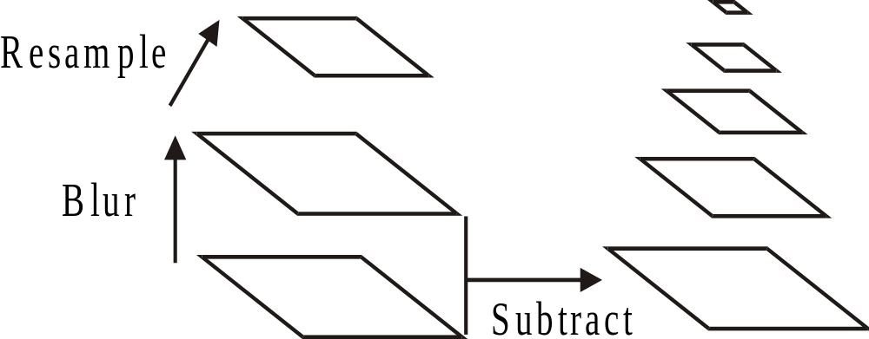
Build Scale-Space Pyramid
All scales must be examined to identify scale-invariant features
An efficient function is to compute the Difference of Gaussian (DOG) pyramid (Burt & Adelson, 1983) (or Laplacian)
Computer Vision : CISC 4/689

Slide 41
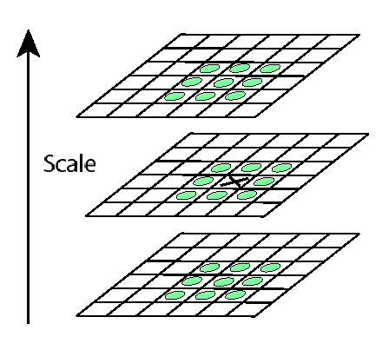
Key point localization
Detect maxima and minima of difference-of-Gaussian in scale space
Computer Vision : CISC 4/689

Slide 42
Scale Invariant Detectors
scale
Harris-Laplacian¹
Find local maximum of:
  Harris corner detector in space (image coordinates)
  Laplacian in scale
← Laplacian →
y
← Harris →
x
SIFT (Lowe)²
Find local maximum of:
  Difference of Gaussians in space and scale
scale
← DoG →
y
← DoG →
x
¹ K.Mikolajczyk, C.Schmid. “Indexing Based on Scale Invariant Interest Points”. ICCV 2001
² D.Lowe. “Distinctive Image Features from Scale-Invariant Keypoints”. Accepted to IJCV 2004
Computer Vision : CISC 4/689

Slide 43
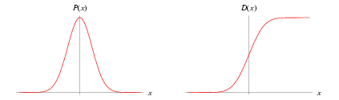

Normal, Gaussian..
A normal distribution in a variate with mean μ and variance σ² is a
statistic distribution with probability function
Computer Vision : CISC 4/689

Slide 44
Harris-Laplacian
Existing methods search for maxima in the 3D representation of an image (x,y,scale). A feature point represents a local maxima in the surrounding 3D cube and its value is higher than a threshold.
THIS (Harris-Laplacian) method uses Harris function first, then selects points for which Laplacian attains maximum over scales.
First, prepare scale-space representation for the Harris function. At each level, detect interest points as local maxima in the image plane (of that scale) – do this by comparing 8-neighborhood. (different from plain Harris corner detection)
Second, use Laplacian to judge if each of the candidate points found on different levels, if it forms a maximum in the scale direction. (check with n-1 and n+1)
Computer Vision : CISC 4/689

Slide 45
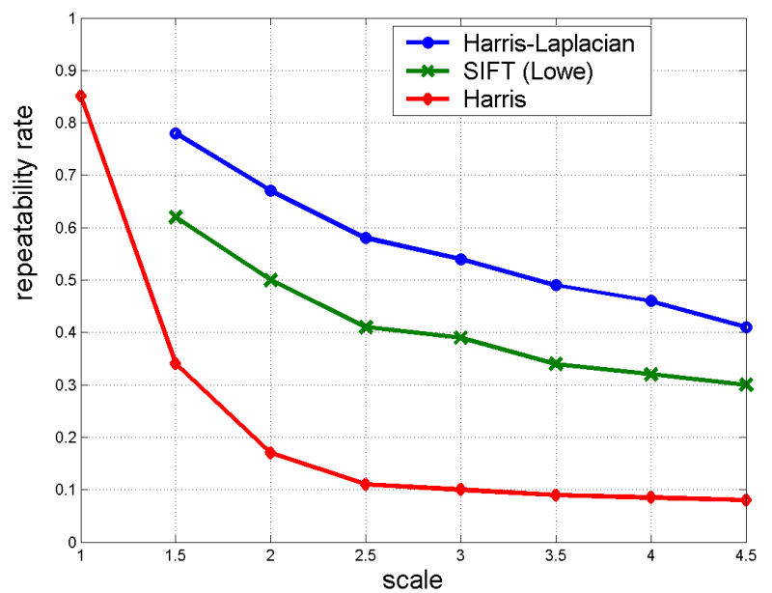
Scale Invariant Detectors
Experimental evaluation of detectors
w.r.t. scale change
Repeatability rate:
# correspondences
# possible correspondences
(points present)
Computer Vision : CISC 4/689
K.Mikolajczyk, C.Schmid. “Indexing Based on Scale Invariant Interest Points”. ICCV 2001

Slide 46
Scale Invariant Detection: Summary
Given: two images of the same scene with a large scale difference between them
Goal: find the same interest points independently in each image
Solution: search for maxima of suitable functions in scale and in space (over the image)
Methods:
Harris-Laplacian [Mikolajczyk, Schmid]: maximize Laplacian over scale, Harris’ measure of corner response over the image
SIFT [Lowe]: maximize Difference of Gaussians over scale and space
Computer Vision : CISC 4/689

Slide 47
Contents
Harris Corner Detector
  Description
  Analysis
Detectors
  Rotation invariant
  Scale invariant
  Affine invariant (maybe later)
Descriptors
  Rotation invariant
  Scale invariant
  Affine invariant
Computer Vision : CISC 4/689

Slide 48
Affine Invariant Detection
Above we considered:
Similarity transform (rotation + uniform scale)
Now we go on to:
Affine transform (rotation + non-uniform scale)
Computer Vision : CISC 4/689

Slide 49
Affine Invariant Detection
Take a local intensity extremum as initial point
Go along every ray starting from this point and stop when extremum of function f is reached
f
points along the ray
We will obtain approximately corresponding regions
Remark: we search for scale in every direction
T.Tuytelaars, L.V.Gool. “Wide Baseline Stereo Matching Based on Local, Affinely Invariant Regions”. BMVC 2000.
Computer Vision : CISC 4/689

Slide 50
Affine Invariant Detection
Algorithm summary (detection of affine invariant region):
  Start from a local intensity extremum point
  Go in every direction until the point of extremum of some function f
  Curve connecting the points is the region boundary
  Compute geometric moments of orders up to 2 for this region
  Replace the region with ellipse
T.Tuytelaars, L.V.Gool. “Wide Baseline Stereo Matching Based on Local, Affinely Invariant Regions”. BMVC 2000.
Computer Vision : CISC 4/689

Slide 51
Affine Invariant Detection : Summary
Under affine transformation, we do not know in advance shapes of the corresponding regions
Ellipse given by geometric covariance matrix of a region robustly approximates this region
For corresponding regions ellipses also correspond
Methods:
Search for extremum along rays [Tuytelaars, Van Gool]:
Maximally Stable Extremal Regions [Matas et.al.]
Computer Vision : CISC 4/689

Slide 52
Contents
Harris Corner Detector
  Description
  Analysis
Detectors
  Rotation invariant
  Scale invariant
  Affine invariant
Descriptors
  Rotation invariant
  Scale invariant
  Affine invariant
Computer Vision : CISC 4/689

Slide 53
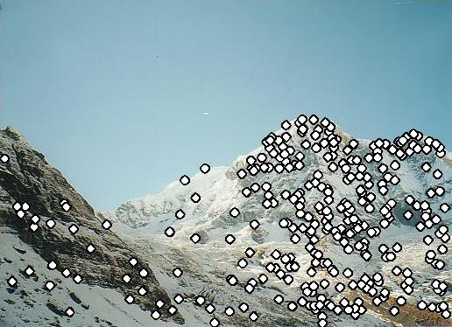
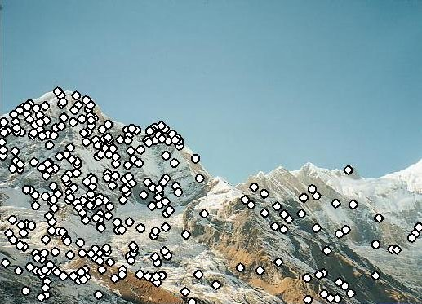
Point Descriptors
Point descriptor should be:
  Invariant
  Distinctive
We know how to detect points
Next question:
How to match them?
?
Computer Vision : CISC 4/689

Slide 54
Contents
Harris Corner Detector
  Description
  Analysis
Detectors
  Rotation invariant
  Scale invariant
  Affine invariant
Descriptors
  Rotation invariant
  Scale invariant
  Affine invariant
Computer Vision : CISC 4/689

Slide 55
Descriptors Invariant to Rotation
Harris corner response measure:
depends only on the eigenvalues of the matrix M
Computer Vision : CISC 4/689
C.Harris, M.Stephens. “A Combined Corner and Edge Detector”. 1988

Slide 56
Descriptors Invariant to Rotation
Find local orientation
Dominant direction of gradient
Compute image derivatives relative to this orientation
¹ K.Mikolajczyk, C.Schmid. “Indexing Based on Scale Invariant Interest Points”. ICCV 2001
² D.Lowe. “Distinctive Image Features from Scale-Invariant Keypoints”. Accepted to IJCV 2004
Computer Vision : CISC 4/689

Slide 57
Contents
Harris Corner Detector
  Description
  Analysis
Detectors
  Rotation invariant
  Scale invariant
  Affine invariant
Descriptors
  Rotation invariant
  Scale invariant
  Affine invariant
Computer Vision : CISC 4/689

Slide 58
Descriptors Invariant to Scale
Use the scale determined by detector to compute descriptor in a normalized frame
For example:
  moments integrated over an adapted window (region
  for that scale.
  derivatives adapted to scale: sI_{x}
Computer Vision : CISC 4/689

Slide 59
Contents
Harris Corner Detector
  Description
  Analysis
Detectors
  Rotation invariant
  Scale invariant
  Affine invariant
Descriptors
  Rotation invariant
  Scale invariant
  Affine invariant
Computer Vision : CISC 4/689

Slide 60
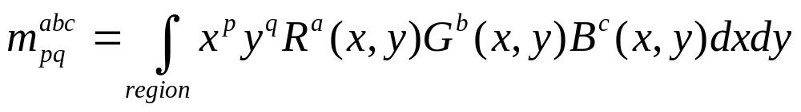
Affine Invariant Descriptors
Affine invariant color moments
Different combinations of these moments are fully affine invariant
Also invariant to affine transformation of intensity I → a I + b
Computer Vision : CISC 4/689
F.Mindru et.al. “Recognizing Color Patterns Irrespective of Viewpoint and Illumination”. CVPR99

Slide 61
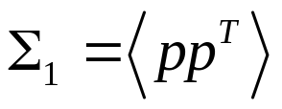
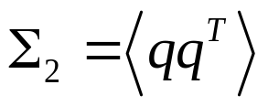


Affine Invariant Descriptors
Find affine normalized frame
A
A₁
A₂
rotation
Compute rotational invariant descriptor in this normalized frame
Computer Vision : CISC 4/689
J.Matas et.al. “Rotational Invariants for Wide-baseline Stereo”. Research Report of CMP, 2003

Slide 62
RANSAC
How to deal with outliers?
Computer Vision : CISC 4/689

Slide 63
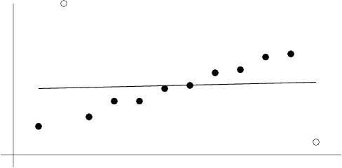
The Problem with Outliers
Least squares is a technique for fitting a model to data that exhibit a Gaussian error distribution
When there are outliers—data points that are not drawn from the same distribution—the estimation result can be biased
i.e, mis-matched points are outliers to the Gaussian error distribution
which severely disturb the Homography.
Line fitting using
regression is
biased by outliers
Computer Vision : CISC 4/689
from Hartley & Zisserman

Slide 64
Robust Estimation
View estimation as a two-stage process:
  Classify data points as outliers or inliers
  Fit model to inliers
  Threshold is set according to measurement noise (t=2σ, etc.)
Computer Vision : CISC 4/689

Slide 65
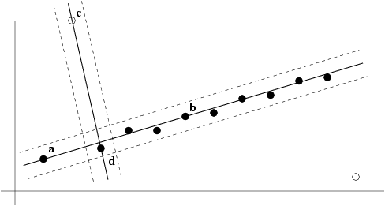
RANSAC
(RANdom SAmple Consensus)
Randomly choose minimal subset of data points necessary to fit model (a sample)
Points within some distance threshold t of model are a consensus set. Size of consensus set is model’s support
Repeat for N samples; model with biggest support is most robust fit
  Points within distance t of best model are inliers
  Fit final model to all inliers
Two samples
and their supports
for line-fitting
Computer Vision : CISC 4/689
from Hartley & Zisserman

Slide 66
RANSAC: Picking the Distance Threshold t
Usually chosen empirically
But…when measurement error is known to be Gaussian with mean ¹ and variance ¾²:
  Sum of squared errors follows a Â² distribution with m DOF, where m is the DOF of the error measure (the codimension)
    E.g., m = 1 for line fitting because error is perpendicular distance
    E.g., m = 2 for point distance
Examples for probability ® = 0.95 that point is inlier
m | Model | t²
1 | Line, fundamental matrix | 3.84 ¾²
2 | Homography, camera matrix | 5.99 ¾²
Computer Vision : CISC 4/689

Slide 67
The Algorithm
selects minimal data items needed at random
estimates parameters
finds how many data items (of total M) fit the model with parameter vector, within a user given tolerance. Call this K.
if K is big enough, accept fit and exit with success.
repeat above steps N times
fail if you get here
Computer Vision : CISC 4/689

Slide 68
How Many Samples?
  = probability of N consecutive failures
  = {(prob that a given trial is a failure)}^{N}
  = (1 - prob that a given trial is a success) ^{N}
  = [1 - (prob that a random data item fits the model ) ^{s}] ^{N}
Computer Vision : CISC 4/689

Slide 69
RANSAC: How many samples?
Using all possible samples is often infeasible
Instead, pick N to assure probability p of at least one sample (containing s points) being all inliers
where ² is probability that point is an outlier
Typically p = 0.99
Computer Vision : CISC 4/689

Slide 70
RANSAC: Computed N (p = 0.99)
Sample size | Proportion of outliers ²
s | 5% | 10% | 20% | 25% | 30% | 40% | 50%
2 | 2 | 3 | 5 | 6 | 7 | 11 | 17
3 | 3 | 4 | 7 | 9 | 11 | 19 | 35
4 | 3 | 5 | 9 | 13 | 17 | 34 | 72
5 | 4 | 6 | 12 | 17 | 26 | 57 | 146
6 | 4 | 7 | 16 | 24 | 37 | 97 | 293
7 | 4 | 8 | 20 | 33 | 54 | 163 | 588
8 | 5 | 9 | 26 | 44 | 78 | 272 | 1177
adapted from Hartley & Zisserman
Computer Vision : CISC 4/689

Slide 71
Example: N for the line-fitting problem
n = 12 points
Minimal sample size s = 2
2 outliers ) ² = 1/6 ¼ 20%
So N = 5 gives us a 99% chance of getting a pure-inlier sample
  Compared to N = 66 by trying every pair of points
Computer Vision : CISC 4/689
from Hartley & Zisserman

Slide 72
RANSAC: Determining N adaptively
If the outlier fraction ² is not known initially, it can be estimated iteratively:
    Set N = 1 and outlier fraction to worst case—e.g., ² = 0.5 (50%)
    For every sample, count number of inliers (support)
    Update outlier fraction if lower than previous estimate:
    ² = 1 ¡ (number of inliers) / (total number of points)
    Set new value of N using formula
    If number of samples checked so far exceeds current N, stop
Computer Vision : CISC 4/689

Slide 73
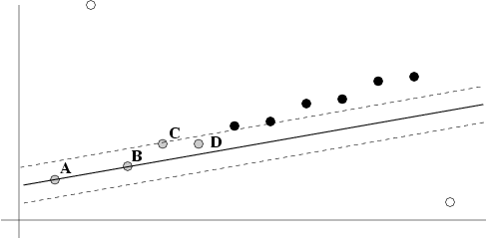
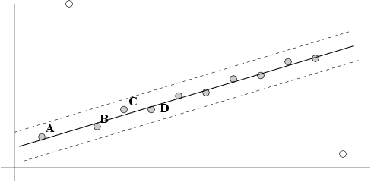
After RANSAC
RANSAC divides data into inliers and outliers and yields estimate computed from minimal set of inliers with greatest support
Improve this initial estimate with estimation over all inliers (i.e., standard minimization)
But this may change inliers, so alternate fitting with re-classification as inlier/outlier
from Hartley & Zisserman
Computer Vision : CISC 4/689

Slide 74

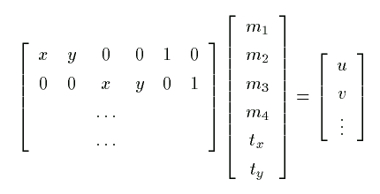
Applications of RANSAC:
Solution for affine parameters
Affine transform of [x,y] to [u,v]:
Rewrite to solve for transform parameters:
Computer Vision : CISC 4/689

Slide 75
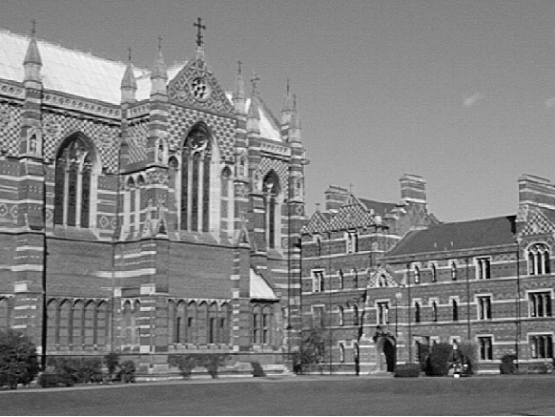
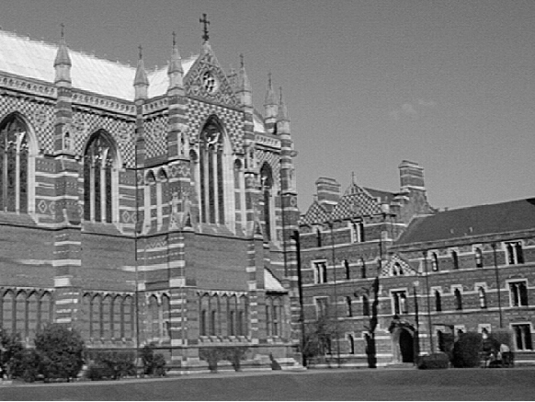
Another app. : Automatic Homography H Estimation
How to get correct correspondences without human intervention?
from Hartley & Zisserman
Computer Vision : CISC 4/689

